Slide 1





For
Niyandagala
“Ambroshia” Tea
Uva Co (Pvt) Ltd.
ITP2020_S2_05_G2

Slide 2

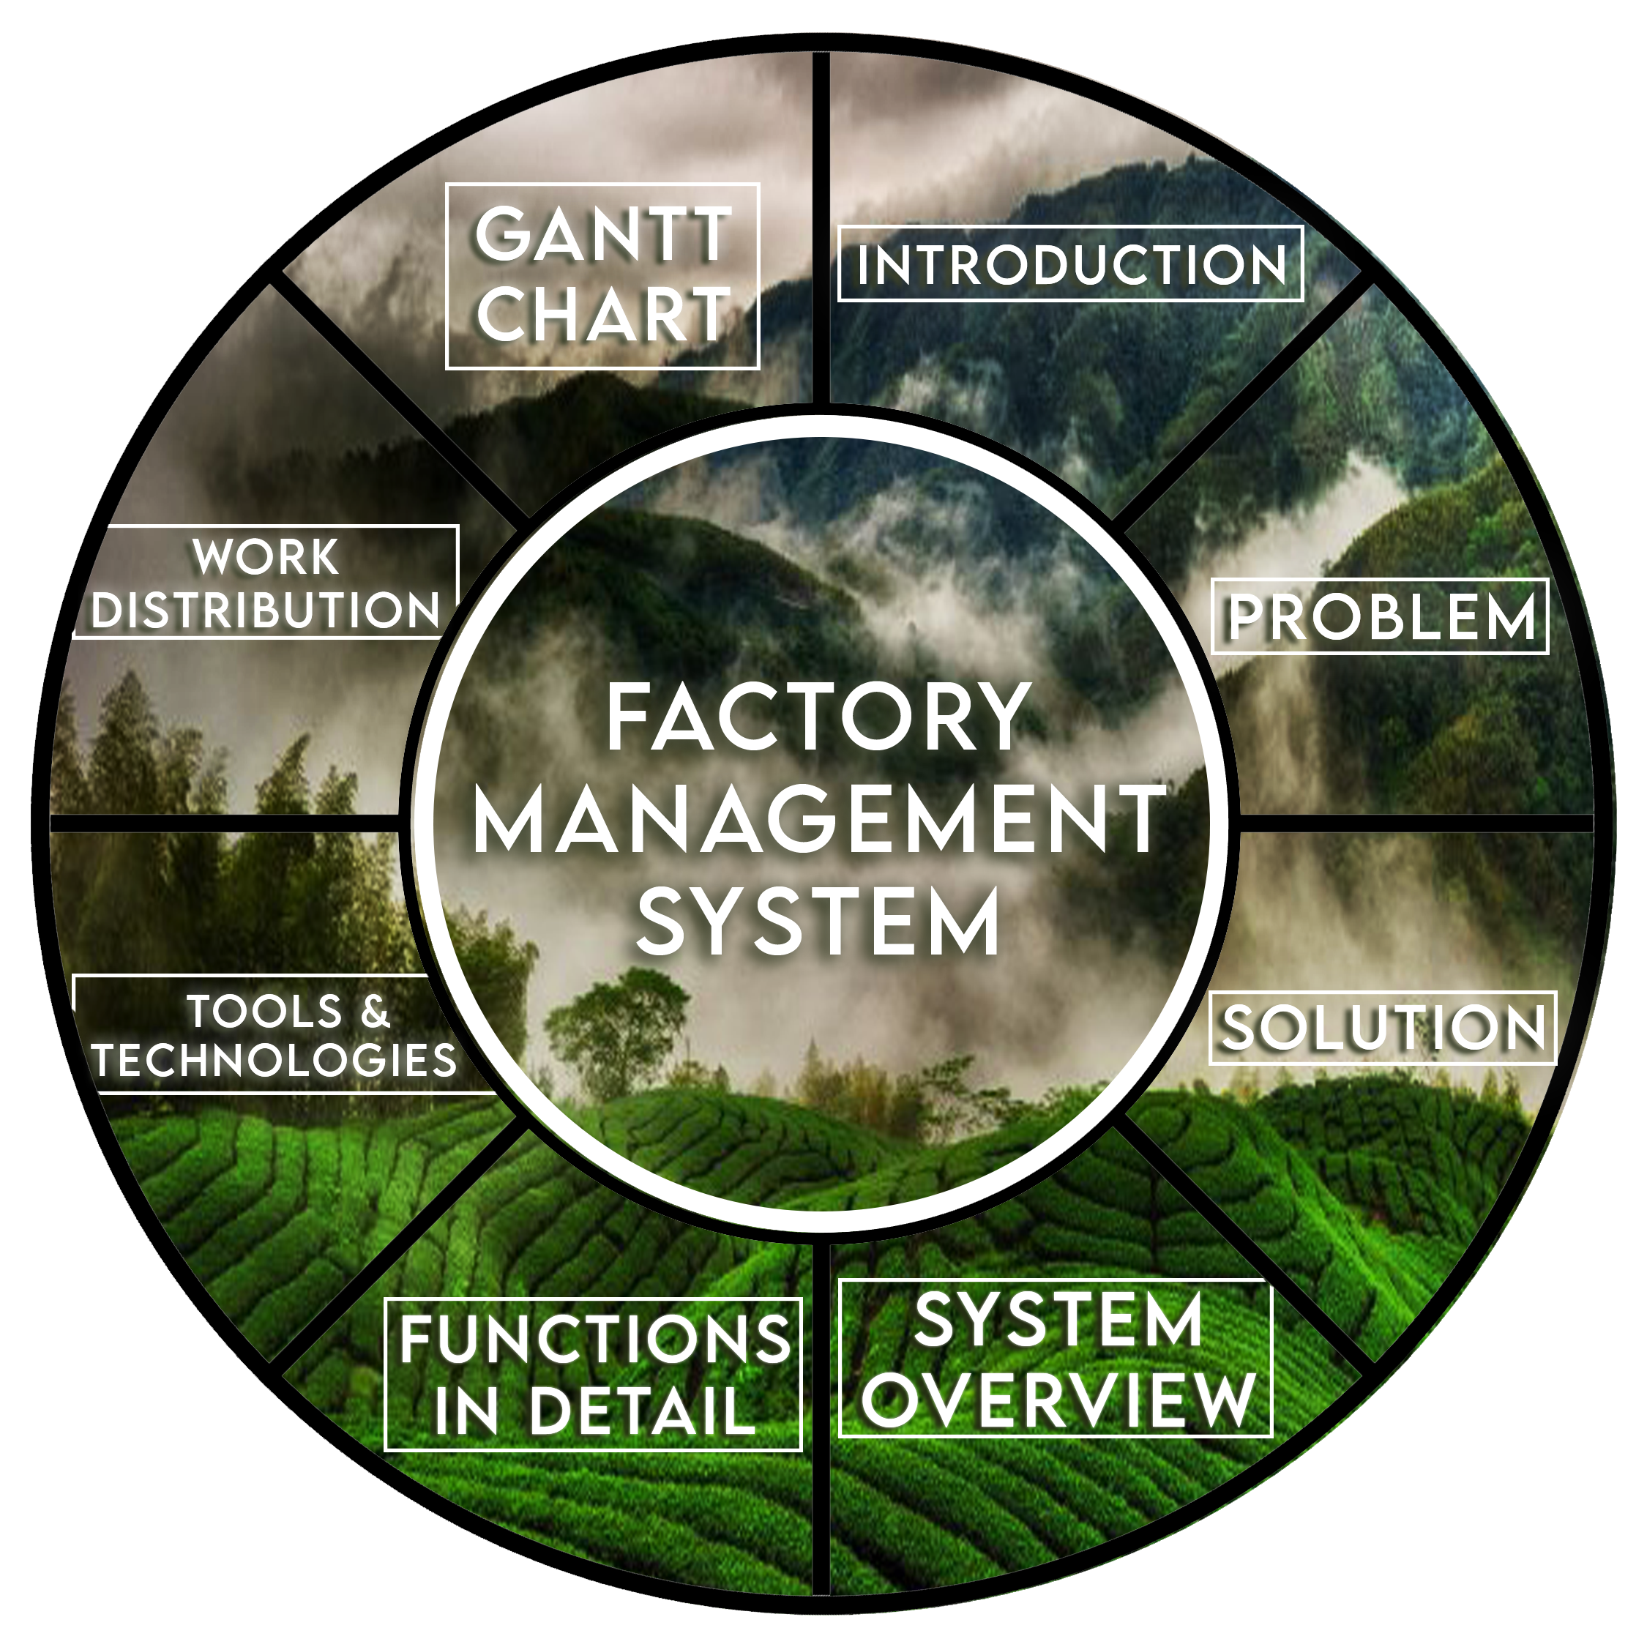


Slide 3

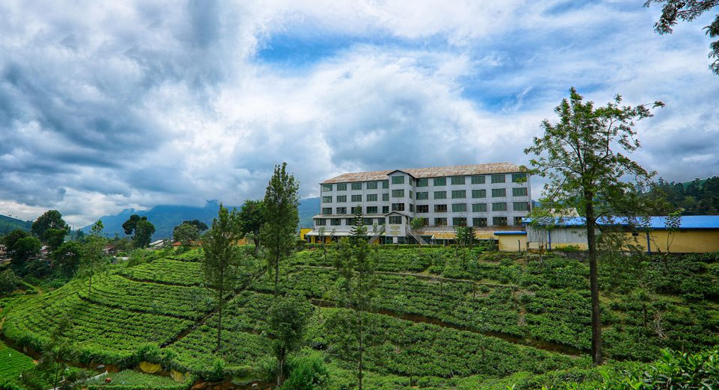

INTRODUCTION
Our Client : Niyandagala “Ambroshia” Tea Uva Co (Pvt) Ltd

Slide 4

PROBLEM
No proper system to record details
Calculations done manually
Inefficient data access
Data inaccuracy

Slide 5


SOLUTION
Online web based system with a database
Calculations can be done automatically with the system
Client Can access any data records in seconds

Slide 6
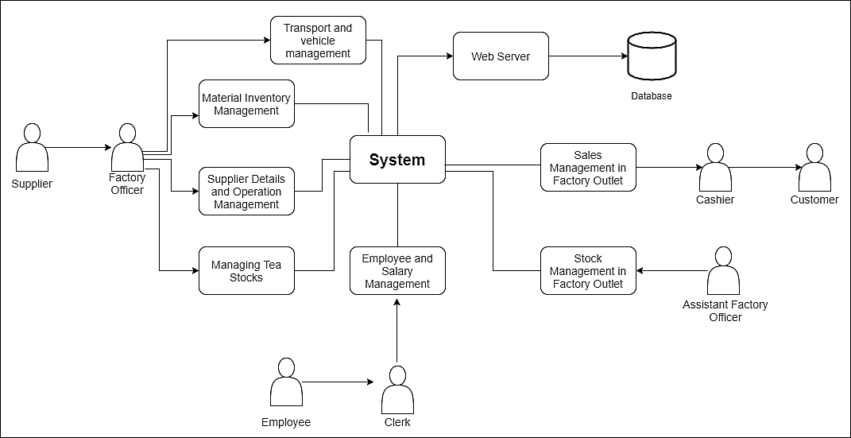
System Overview

Slide 7
FUNCTIONS IN DETAIL

Slide 8
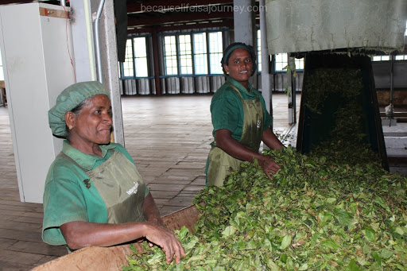
Employee Management System
Employee Details and Attendance Management
Registering workers and staff members
Updating details of the workers
Displaying past records and profiles of workers
Managing daily attendance of workers
Calculating the total working days of the month
to calculate salary, EPF, ETF, etc.
IT19000336 - Mudannayake I.G.M.J.

Slide 9

Employee Management System
Calculating salaries of employees
Calculating the salaries of staff members monthly
Calculating the salaries of workers based on their daily attendance
Adding EPF/ETF and other annual bonuses to the basic salary calculating the monthly full salary
IT19008110 - Perera L.A.V.U.

Slide 10

Transport and Vehicle Repair Management
Registering vehicles
Updating vehicle details
Calculating total expenditure went for fuel in a month
Calculating total expenditure went for vehicle repairs
IT19046976 - Amarawansa T.N.W.

Slide 11


Supplier Details and Operations Management
Register Suppliers
Add / Update Suppliers’ stock details
Delete Supplier records
Calculate Supplier payments
Generate reports
IT19039350 - Siriwardana S.M.T.N.

Slide 12
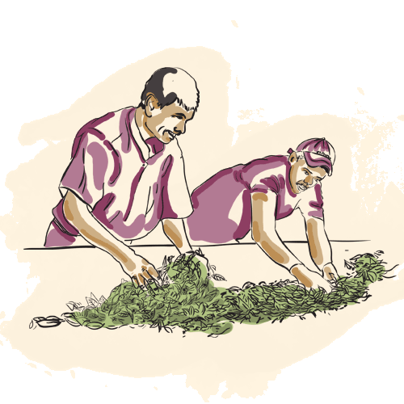
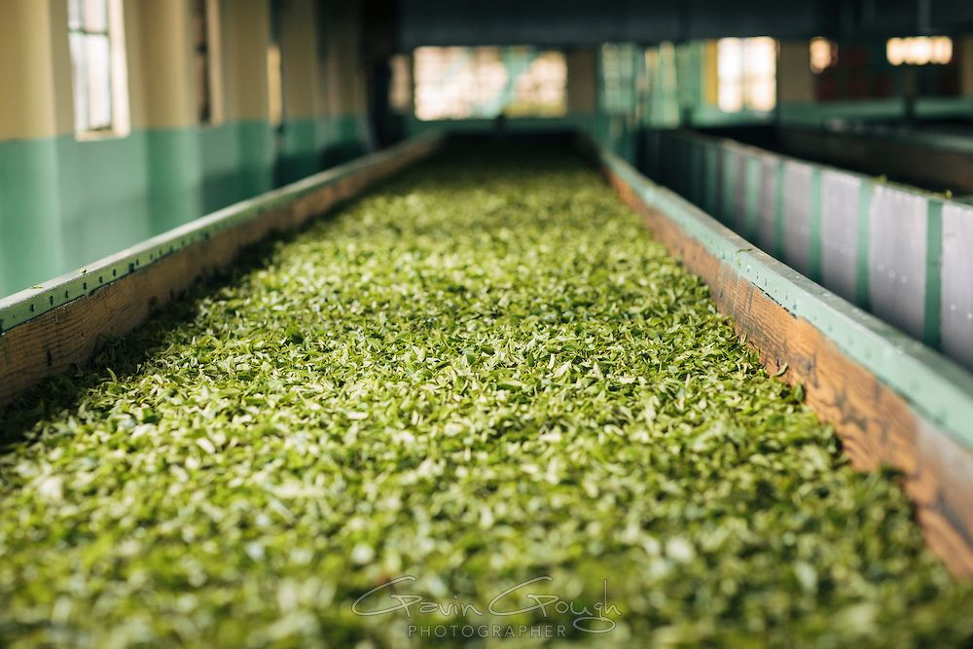
Managing Supplier Stocks
Recording the details when adding fresh tea leaves to trays
Must record the “in time” and the “temperature”
Updating when a new tea leaf stock get added to a tray
Display a weekly report of the tea leaves sent to the machine
IT19210148 - Wijethunga R.M.

Slide 13

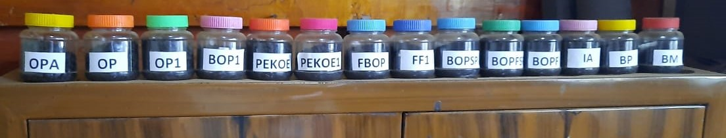
Final Tea Production Stock Management
Add final tea production details
Update tea production details according to the orders
Manage production categories
Calculate total production
Calculate final production cost
IT19362854 - Abeygunawardana S.L.

Slide 14
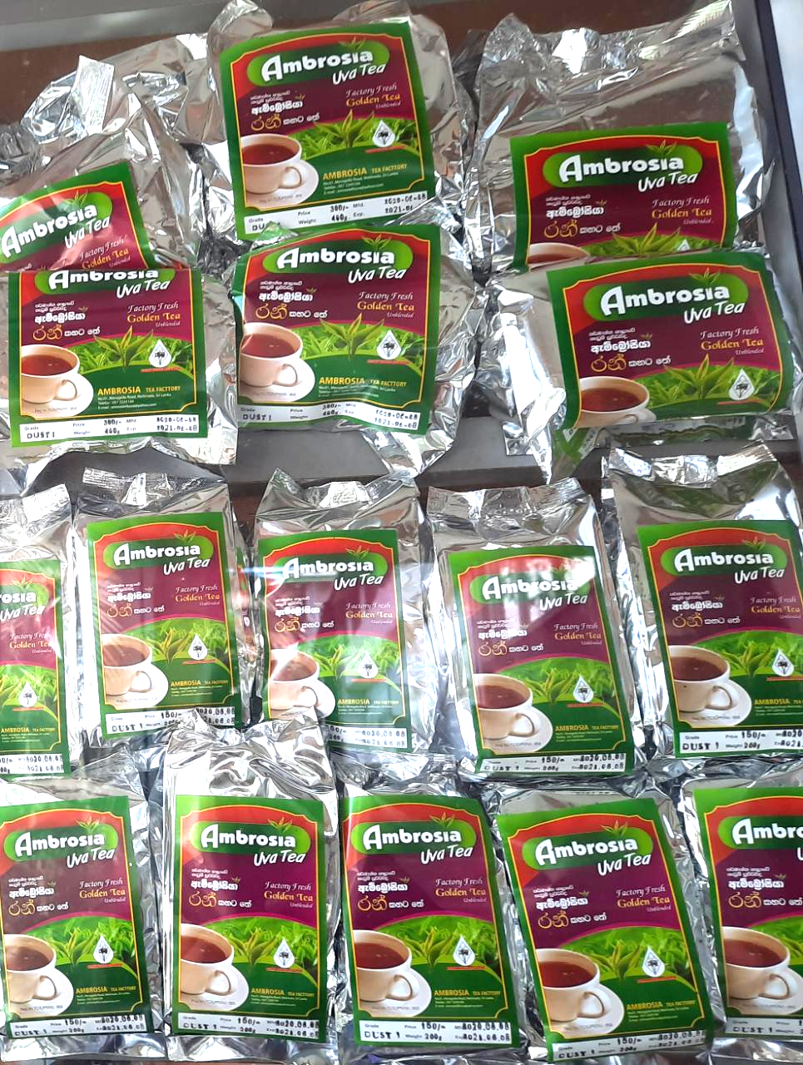
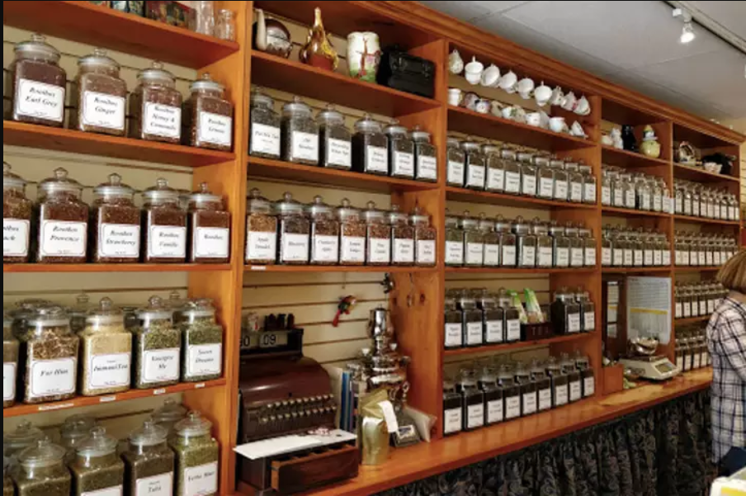
Factory Outlet
Stock Management
Insert and delete number of packets (Admin insert number of packets manually)
update the amount of current stock (System will update the current stock)
display reports of stocks (Display weekly report)
IT19009728 - Amaranayake W. N. S

Slide 15


Factory Outlet
Sales Management
Insert the buying items of customer’s and calculate the bill amount of sold items
Display the receipt.
Calculate and updated income and display
(Calculate the daily, weekly, monthly, yearly income of the tea shop)
Display sold items
(View the sold items amount of the categorized tea packets)
IT19041926 - Onella Natalie P.A.D.

Slide 17



Tools and Technologies
Python Programming language with Django Framework
MySQL Database

Slide 18

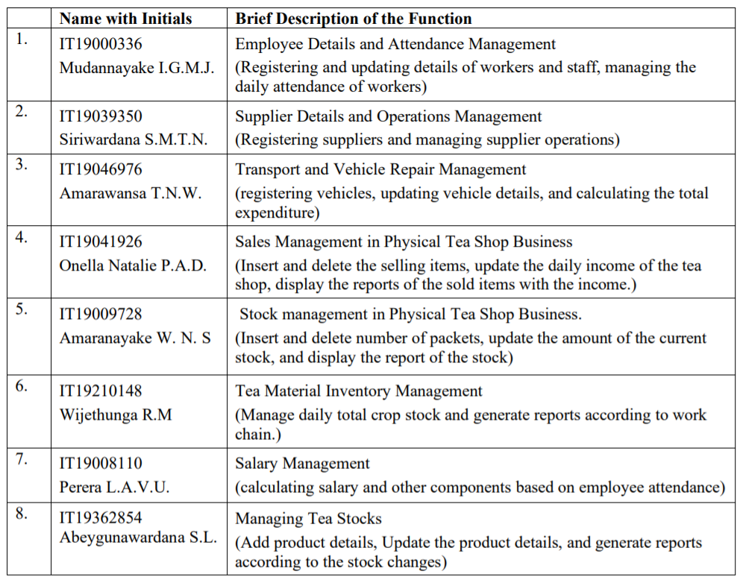
Work Distribution among Members

Slide 19

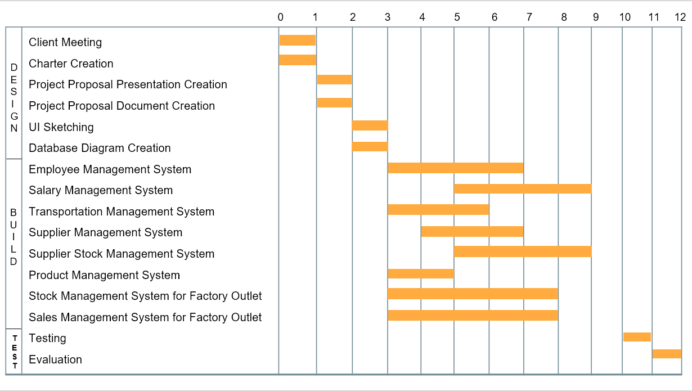
Gantt Chart ( 12 Weeks )

Slide 20
Thank you!
ITP2020_S2_05_G2

